Slide 1
Sensor Training
Garnet Squadron 4901
Presented by: Ryan Nazaretian

Slide 2
Shaft Encoders – Two Types
Incremental
Absolute
Counts how many ticks from starting point
Can be directional
Need to have point of reference
Simple electrical interface (2 digital inputs)
Keeps track of the angle of the shaft at all times
More complicated electrical interface
Analog – Cannot rotate fast, 1 analog input
Digital – log₂(ticks) inputs needed (360 would require 8.49) 9 inputs)

Slide 3
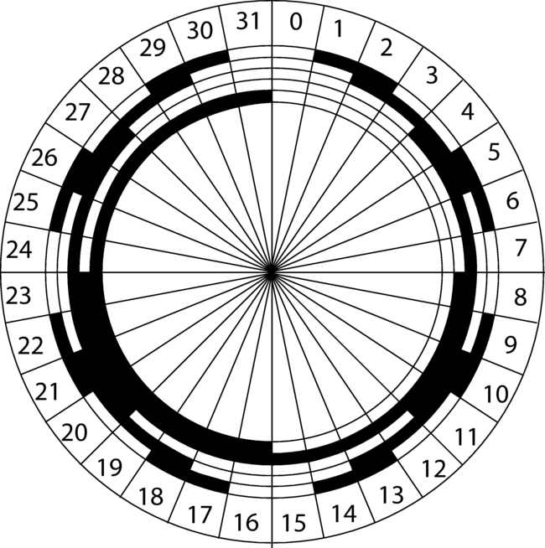
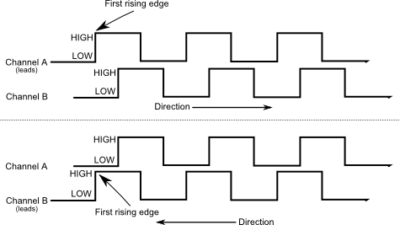
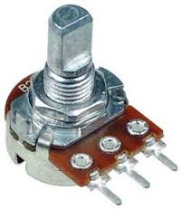
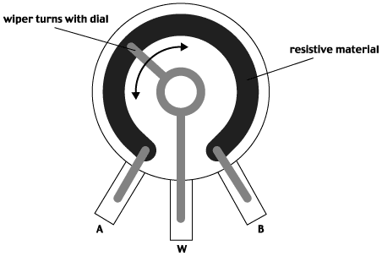
Shaft Encoder – How they work
Incremental
Absolute
Quadrature - Two digital outputs, A & B
Digital
Analog
Gray Encoding
1 bit changes at a time
Ground
Out
+5V

Slide 4
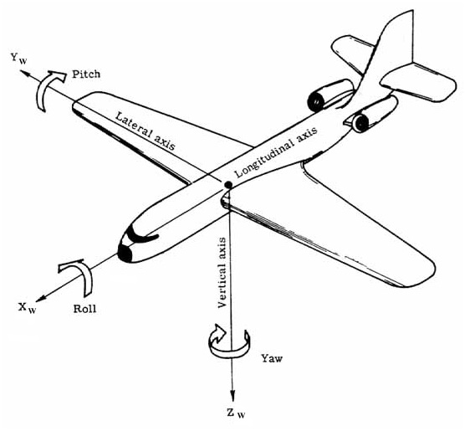
Inertial & Free-space Sensors
Accelerometer
Measures linear acceleration (m/s²) in 3 axes:
Z – Up and Down (usually outputs 1g due to gravity)
X – Think left and right acceleration
Y – Thinking forward and reverse acceleration
Uses?
Sensor fusion… more on that later
Problems?
Not very useful on its own
Not good at figuring out velocity or position using integration
Gyro
Measures angular velocity (rad/s)
Yaw – rotation about Z
Pitch – rotation about X
Roll – rotation about Y
But it’s acceleration, not position!
Right… integrate velocity and you get?
Position!
Uses?
Robot orientation
Problems?
It drifts continuously. Needs to be fused to another sensor.
More on that later.

Slide 5
Inertial & Free-space Sensors - Contd.
Magnetometer
Measures magnetic flux
Essentially an electronic compass
Uses:
Robot orientation
Problems?
Not very accurate.
Electric motors and high electrical current can mess up the readings
<s>Good thing we don’t have any of that on a robot!</s>
Sensor Fusion
A complicated algorithm to ‘fuse’ together multiple sensors such as the accelerometer, gyroscope, and magnetometer, all of which make up an Inertial Measurement Unit, or IMU.
By ‘fusing’ together all three sensors, high orientation accuracy can be achieved.
One good algorithm I’ve used: Sebastian Madgwick, C and C# code available
Someone was nice to post LabVIEW source code too!
Search Sparkfun for 9 Degrees of Freedom (3x Accelerometer, 3x Gyro, 3x Mangetometer)
Anyone want to see a video?

Slide 6
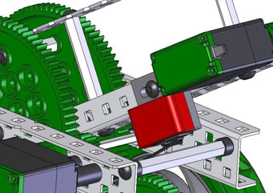
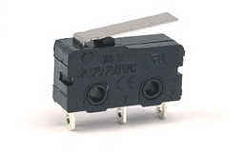
Limits and Process Control
What if we need our robot to stop at a single position or to do something when something is triggered?
Limit Switch
Simplest device to use
Usually 3 pins:
C – Common pin – connect to ground
NC – Normally Closed – When released, it’s pulled to ground; connects to DIO on controller
NO – Normally Open – When pressed, it’s pulled to ground; connects to DIO on controller
You don’t need to connect both NC and NO to the controller.
Example:
If switch disables motion, use NC for safety (if wire is disconnected, motor will not move, preventing damage)
If switch disables motion, use NO for reliability (if wire is disconnected, motor can still move, but driver must be responsible for his/her actions)

Slide 7
Limits and Process Control – Contd.
Retroreflective Sensor
Think of the garage door
Great for process control
Is there a ball in the hopper?
Do we have a Frisbee?
Proximity / Distance
Used to detect objects or walls
Ultrasonic such as Maxbotix, or Sharp IR sensors
How far away are we from the wall?
How high off the floor is the lift?
How many balls are on the hopper?

Slide 8
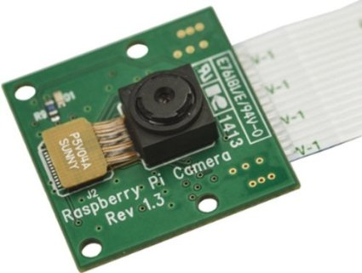
Vision
Vision has been used within FRC since 2005. Imagine doing vision processing on a 40 MHz processor with only a few kilobytes of RAM.
Vision doesn’t require high power computing
The trick is to do have a high rate of return with the least amount of work. That’s engineering!
Instead of processing a 1920x1080 resolution, what if we can get by with processing a 320x240?
The camera captures images at 30 FPS, what if we can get by with only processing 5 FPS?

Slide 9
Vision – Contd.
But I want/need to process more often because I want to track a target while moving at 15 feet/s.
Okay… how about we process images off-board.
What about the driver station? It’s pretty powerful.
Right, but it’s on wireless with 5 other robots and hundreds of spectators that are crowding the wireless environment. You’ll have to deal with latency and dropped packets. Probably not a good idea.
How about we strap on a powerful laptop?
Is that powerful laptop under $400 per 2015 rule R10? Probably not.
So what do we do?
We can get away with a low powered computer such as a Raspberry Pi or BeagleBone running Linux and OpenCV.
The RoboRIO is also pretty powerful. We can probably use a lower resolution while processing at a high frame rate.

Slide 10
Vision – Contd.
What camera should we get?
I can’t say what we should get, but here are a few things to look out for:
No auto-focus - It’s like auto-correct. It’s nice when it works, but how often does it do what you want it to do?
Solid mounting – The robot and camera are calibrated together assuming the robot is part of the robot. If it’s zip tied or taped on, it’s likely that it will move. Soon your perfect basketball shooting robot will look like one of us engineers trying to shoot some hoops.

Slide 11
Vision – Contd.
I keep hearing about this retroreflective stuff, but it doesn’t look like it’s from the ’70s. What’s so retro about it?
Retroreflective talks about the material’s ability to reflect back in the same direction
Reflective
Retroreflective

Slide 12
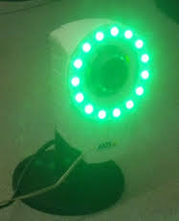
Vision – Contd.

Slide 13
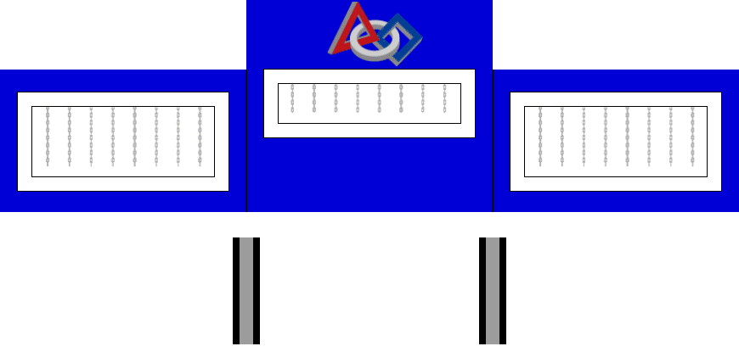
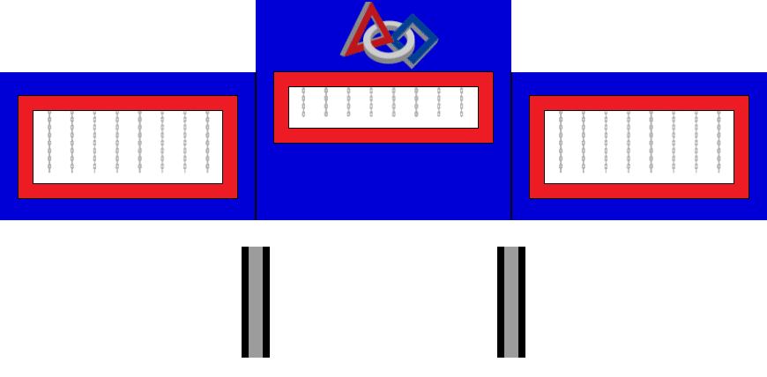
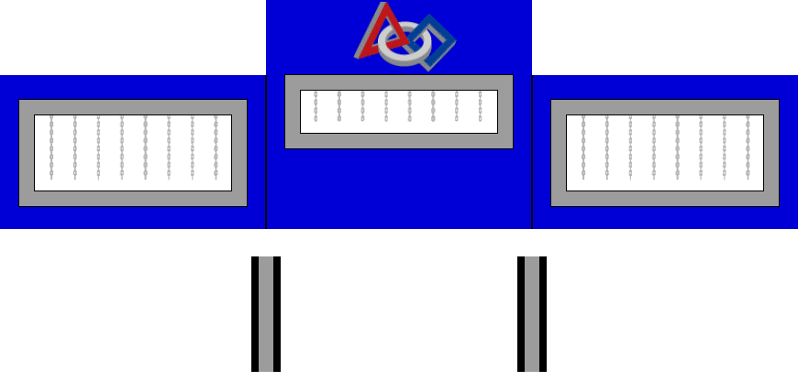
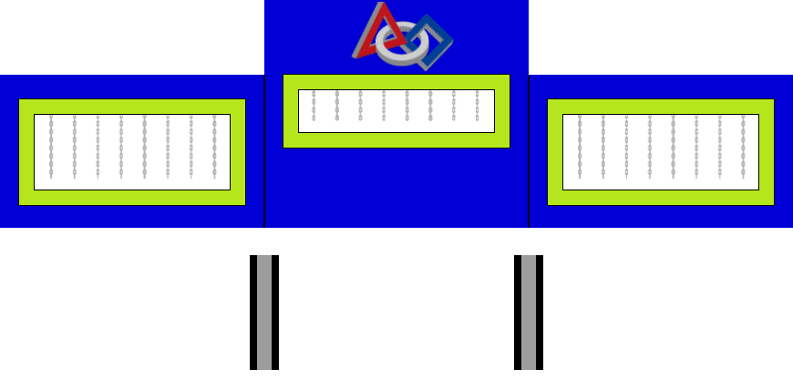
Vision – Contd.

